Slide 1
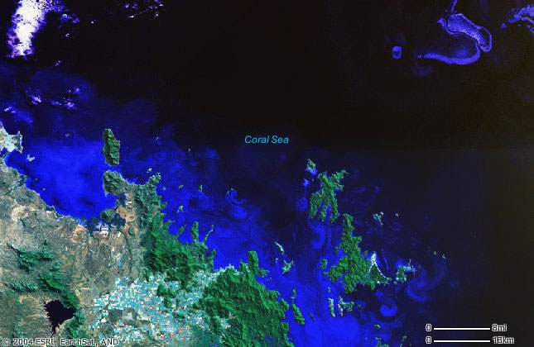
Adventure Works Marketing

